Slide 1
TDT4258: Low-Level Programming
- Course Introduction
Rakesh Kumar
Computer Architecture Lab
Department of Computer Science

Slide 2
What is this course about?
Goal: Learning software development for Embedded Systems
But, first understand the hardware
Processor and memory organization
Input/output devices and buses
Software development
Assembly and C programming
Compilation and optimizations
Operating system basics

Slide 3
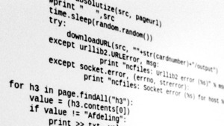
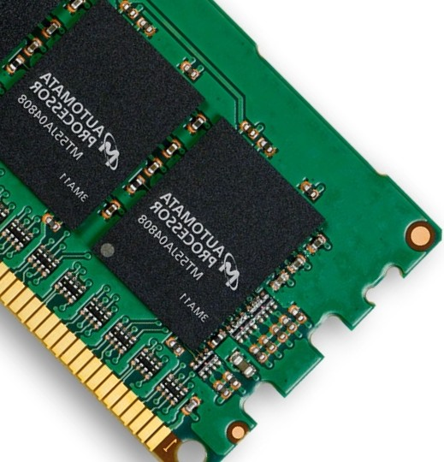
What is this course about?
Hardware

Slide 4
What is this course about?
Compiler
Hardware

Slide 5

What is this course about?
Compiler
OS
Hardware

Slide 6
Course Staff?
Coordinator and Lecturer
Rakesh Kumar
Teaching Assistant
Roman Brunner
Lab demonstrators
Daniel Hansen
Elias Nodland

Slide 7
Lectures: When and Where?
Online: Lectures
Youtube (Recorded lectures)
Available a week before the discussion Sessions
Before-lecture: Take a short quiz after watching the lectures
Take the quiz before 12:00 on Mondays
In-lecture: Discussion/Q&A
Tuesdays, 10:15 – 12:00 @ R8
Format:
Short summary based on the after-lecture quizzes, with Q&A
Quizzes base on previous years exam questions
Watch the lecture videos before the discussion/Q&A

Slide 8
Quiz demo
We will use Mentimeter for quizzes.
Goto: menti.com
Code:
What department are you from?
A: IDI
B: IES
C: IIK
D: Other
Suggestions for alternative platforms are welcome.

Slide 9
Labs: When and Where?
Labs
Wednesdays, 08:15 – 10:00 @ R73 Realfagbygget
Wednesdays, 12:15 – 14:00 @ F3 Gamle Fysikk
Wednesdays, 12:15 – 14:00 @ R54 Realfagbygget
Wednesdays, 14:15 – 16:00 @ MA24 Grønnbygget
Thursdays, 10:15 – 12:00 @ EL1 Gamle Elektro
Register for a lab session on Blackboard
You do/submit the three lab assignments individually
We do check for plagiarism
No labs this week

Slide 10
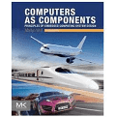
The learning resources
Book
Computers as Components by Marilyn Wolf
Lecture videos and slides
Some lectures go beyond the book
Lab exercise compendium
All the required information of lab exercises
Papers and documents published on Blackboard

Slide 11
Grading
Exam – 100%
In December, exact date will be posted later
Lab assignments
Three mandatory assignments
Grading: Pass/Fail
IMP: You must pass all the assignments and exam to pass the course.
More details about lab assignments will be provided during in-class lectures

Slide 12
Lecture schedule [tentative]
Week | Lecture
34 | Lecture 0: Course Introduction
35 | Lecture 1: Introduction to Assembly Language
36 | Lecture 2: More assembly and input/output
37 | Lecture 3: Processor and memory
38 | Lecture 4: Caches and Virtual memory
39 | (Guest) Lecture 5: Tools for embedded computing
40 | Lecture 6: Introduction to programming in C
41 | (Guest) Lecture 7: Resource constrained programming
42 | Lecture 8: Compilation and optimizations
43 | Lecture 9: Introduction to operating systems
44 | (Guest) Lecture 10: ARM mbed platform
45 | Lecture 11: Power and wrapup
46 | Reserved
47 | Reserved

Slide 13

How to do well in this course?
Keep pace with the lectures
Watch the videos in due time
Start working on the lab exercise early
They are work intensive
Take advantage of scheduled lab hours
Don’t wait till the last day → Lab demonstrators will be busy
Be active (on Piazza): ask questions, help others,…
DO NOT CHEAT
Read NTNU guidelines on Plagiarism.

Slide 14
Next steps
Signup for a lab session
Signup on Piazza
Link on Blackboard
Volunteers for reference group
Email me by next Tuesday

